Slide 2
JDP Kart Tech Safety Inspection
Ad Hoc Committee on Kart Safety
Steve Hudson (SEB), chair
Kathy Barnes (SSC), Paul Russell (KAC), and Dan Cyr (KAC)
Doug Gill (Liaison)

Slide 3
Kart Tech
Solo® Rules section 3.3.3, Safety Inspection
Annual Inspection (optional)
… Annual Safety Inspection is not permitted for Junior Driver karts; they must be inspected at each event. …

Slide 4
Kart Tech
Solo® Rules Appendix G.III, Kart Tech Inspectors:
Any adult SCCA® member who has completed kart safety (tech) inspector training.

Slide 5
Kart Tech
Solo® Rules section 19.1.A, Frame Dimensions (applies to all karts):
The following chassis connections must be secured by …

Slide 6
Safety wire
Kart Tech

Slide 7
Kart Tech
Safety wire

Slide 8
Cotter pin Split pin
Kart Tech

Slide 9
Hitch pin Hairpin clip R-clip
Kart Tech

Slide 10
Bowtie pin
Kart Tech

Slide 11
Circle pin
Kart Tech

Slide 12
Circlip Snap ring
Kart Tech

Slide 13
Metal lock nut
Kart Tech

Slide 14
Nyloc® nut
Kart Tech

Slide 15
Keps® nut
Kart Tech

Slide 16
Nord-Lock® washer
Kart Tech

Slide 17
Nord-Lock® washer
Kart Tech

Slide 18
Steering wheel to hub bolts
Kart Tech
Check List

Slide 19
Kart Tech
Check List
Steering hub to shaft bolt(s)

Slide 20
Steering shaft to chassis bolt(s) and nut(s)
Kart Tech
Check List

Slide 21
Steering shaft to chassis bolt(s) and nut(s) (uniball)
Kart Tech
Check List

Slide 22
Tie rod end bolts and nuts
Kart Tech
Check List

Slide 23
Kingpin bolts and nuts
Kart Tech
Check List

Slide 24
Front wheel spindle nut
Kart Tech
Check List

Slide 25
Kart Tech – Check List
Steering Assembly:
Steering wheel to hub bolts
Steering hub to shaft bolt
Steering shaft to chassis bolts
Tie Rod end bolts
Kingpin bolts
Spindle nut attaching front wheel

Slide 26
Brake safety cable
Kart Tech
Check List

Slide 27
Brake safety cable
Kart Tech
Check List

Slide 28
Master cylinder to chassis bolts and nuts
Kart Tech
Check List

Slide 29
Master cylinder to chassis bolts and nuts
Kart Tech
Check List

Slide 30
Kart Tech
Check List
Caliper(s) to chassis bolts and nuts

Slide 31
Kart Tech
Check List
Caliper(s) to chassis bolts and nuts

Slide 32
Kart Tech
Check List
Brake pad retaining rods

Slide 33
Kart Tech
Check List
Brake rotor to hub bolts and nuts
no
Nyloc®
fasteners!

Slide 34
Kart Tech – Check List
Brake Assembly:
Brake safety cable present and connected.
Master cylinder to chassis bolts.
Caliper(s) to chassis bolts.
Brake pad retaining rods (if applicable).
Brake rotor to hub (if applicable, no Nyloc® nuts).
Brake test: sufficient force applied to brake pedal shall prevent wheels being able to turn.

Slide 35
Kart Tech
Check List
Throttle pedal pivot to chassis

Slide 36
Kart Tech
Check List
Brake pedal pivot to chassis

Slide 37
Kart Tech
Check List
Water (coolant) recovery system
and fuel system

Slide 38
Kart Tech
Check List
Water (coolant) recovery system
and fuel system

Slide 39
Kart Tech
Check List
Kart numbers

Slide 40
Kart Tech
Check List
Weight (ballast) mounting
-
5/16 bolt
per 10 lbs
(SAE® Grade 5)

Slide 41
Kart Tech
Check List
Weight (ballast) mounting
-
5/16 bolt
per 10 lbs
(SAE® Grade 5)

Slide 42
Kart Tech
Check List
Pedal extensions

Slide 43
Kart Tech
Check List
Pedal extensions

Slide 44
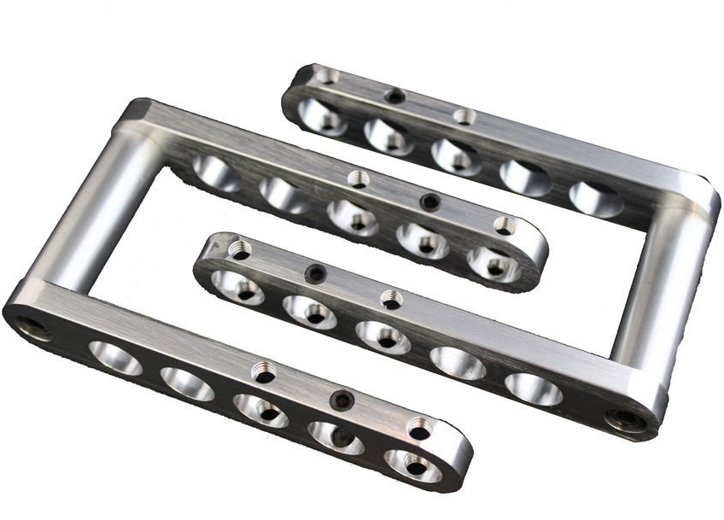
Kart Tech
Check List
Pedal extensions

Slide 45
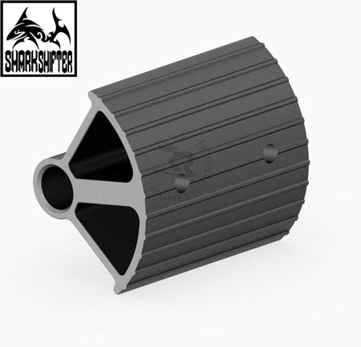
Kart Tech
Check List
Pedal extensions

Slide 46
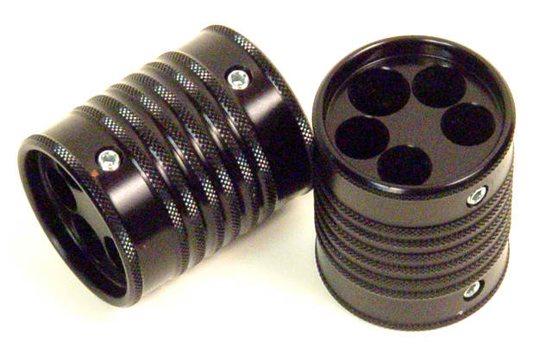
Kart Tech
Check List
Pedal extensions

Slide 47
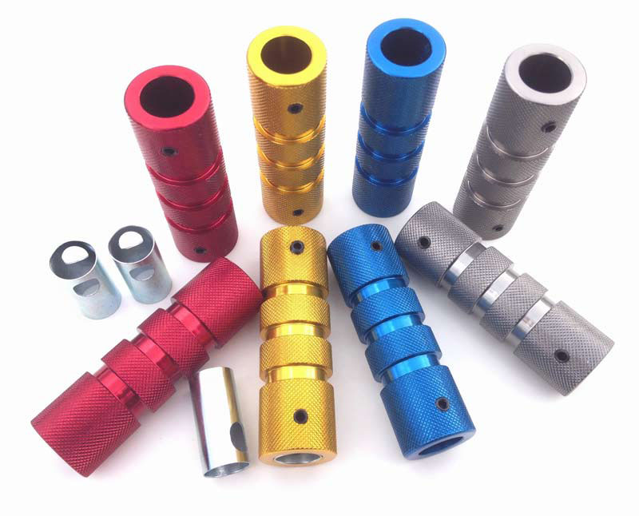
Kart Tech
Check List
Pedal grips

Slide 48
Kart Tech – Check List
Other:
Throttle pedal pivot to chassis.
Brake pedal pivot to chassis.
Functional fuel & water recovery systems (if applicable).
Kart numbers: 6” high in 4 locations.
Weight (ballast) mounting: minimum bolt size 5/16”, SAE® grade 5 (8mm, grade 8.8); 10 lbs. maximum per bolt. Locking nut, pinch nut, double nut, or safety wire. Oversize washer present if mounted through the seat. No weights mounted to nerf bars or moving parts.
Pedal extensions must comply with Solo® Rules.

Slide 49
Doug Gill
SCCA® Solo® Competition Manager
1-800-770-2055
785-357-7222
dgill@scca.com

