Slide 1
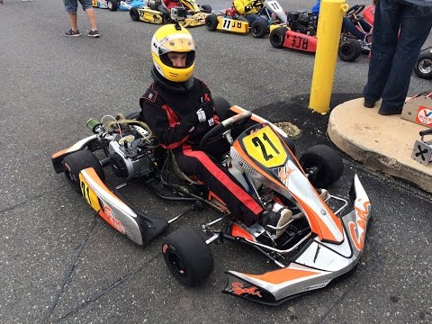

Slide 2
Junior Driver Program Overview
Doug Gill
SCCA® Solo® Competition Manager

Slide 3
Junior Driver Program Overview
Ad Hoc Committee on Kart Safety
Steve Hudson (SEB), chair
Kathy Barnes (SSC), Paul Russell (KAC), and Dan Cyr (KAC)
Doug Gill (Liaison)

Slide 4
Junior Driver Program – Overview
Background
The Junior Kart program is unlike any other in SCCA® Solo®. The age and inherent inexperience of the competitors requires special attention on behalf of the participants by the parents, Solo® Safety Stewards, Youth Stewards, and Regions which host Junior Kart classes at their events.

Slide 5
Junior Driver Program – Overview
Background
The Junior Driver Program was started with the philosophy that having children compete at Solo® events would allow families to participate in and enjoy the Solo® experience together. This program was never intended to be a stepping stone to any type of professional racing career. If this is the goal of the parents and/or children, there are other karting organizations that will provide these types of opportunities.

Slide 6
Junior Driver Program – Overview
Background
Contrasting other classes and categories, SCCA® strictly limits the ability of Regions to modify or augment the rules pertaining to the Junior Driver Program. Event operation, safety, and kart eligibility requirements of the Junior Driver rules must be followed.

Slide 7
Junior Driver Program – Overview
Background
Junior Driver kart classes are supplemental classes and the rules may be changed or supplemented at any time by the Solo® Events Board (SEB) via publication in Fastrack News. This allows for immediate adjustments to address safety concerns. Therefore, reviewing Fastrack News monthly is crucial.
www.scca.com ⇨ ABOUT SCCA  FASTRACK
www.scca.com/pages/fastrack-news

Slide 8
Junior Driver Program – Overview
Going Forward
Topics:
Overview: Kart Safety Awareness – ys, sss, cd, ti
Youth Steward Training – ys
Kart Course Design Training – ys, sss, cd
Kart Safety Inspection (Tech) Training – ys, ti
This training material aims to educate Region Solo® officials with regard to Junior Driver best practices and procedures.

Slide 9
Junior Driver Program – Overview
Going Forward
This is a program where a team of SCCA® designated subject matter experts will provide annual face-to-face training with each Region holding a Kart program to emphasize making safety first and to review procedures and training the Region uses for its Kart program.

Slide 10
Junior Driver Program – Overview
Rules and Changes
The majority of the rules concerning Junior Drivers can be found in Section 19.2 and Appendix H of the Solo® Rules.
Additional rules relating to Junior Drivers and karts in general are in Section 2.2, Course Safety and Layout Rules, and Appendix G, Karts at Solo® Events.
Rule changes for 2018 are discussed throughout the appropriate presentations and are in the handout, “Junior Driver and Kart Safety – Changes to the 2018 Solo® Rules.”

Slide 11
Junior Driver Program – Overview
Kart Course Designer Training
Rule changes are being added to SSS training and the Kart Course Design training for license.
All hazards to karts around the perimeter of the course should be clearly marked and visible to kart drivers.
Examples include: light poles, fences, low hanging obstacles or cables, and trees with low hanging limbs.

Slide 12
Junior Driver Program – Overview
Kart Course Designer Training
Surface irregularities and elevation changes.
Visuals such as the “sea of cones.”
Speeds – karts are faster than many expect.
Obstacles and boundaries.
Finish area.
Grid layout and traffic flow.

Slide 13
Junior Driver Program – Overview
Kart Tech Inspectors
Any adult SCCA® member who has completed kart safety (tech) inspector training.
No annual tech for Junior Driver karts.
All Junior Drivers age 12 and under are required to wear an SFI-certified chest protector.

Slide 14
Junior Driver Program – Overview
Kart Tech Inspectors
Secure chassis connections (Nyloc, safety wire, cotter pin, etc.) for steering, brakes, throttle, wheels, etc.
Kill switch: clearly visible/accessible on the steering wheel, the frame by the fuel tank, top of the front panel, etc. (Going from suggestion to mandatory.)

Slide 15
Junior Driver Program – Overview
Operational Items
Engines engaged by a centrifugal clutch may not be started nor be running while the kart drive wheels are on the ground without a driver in the seat.
On a kart stand, minors are to be a minimum of 3 feet away from the rear rotating axle assembly (engine running).
Pedal extensions must be positively secured to prevent rotation.

Slide 16
Junior Driver Program – Overview
Youth Steward
A licensed position.
An adult SCCA® member in good standing.
Must conduct Junior Driver meeting and safety talk.
Must oversee any kart adjustments made in grid.
Must manage Junior Driver grid operations and course entrance/exit.

Slide 17
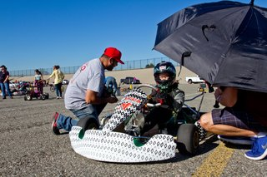
Junior Driver Program – Overview
Thanks for participating!
Questions?

Slide 18
Doug Gill
SCCA® Solo® Competition Manager
1-800-770-2055
785-357-7222
dgill@scca.com

